Slide 1






Lecture 38:
Build Tools - babel & Webpack
Course - Web Development - II
-By
Instructor Name
welcome@krmangalam.edu.in
Sohna Road,Gurugram,Haryana 122103

Slide 2

| Table of Contents
Setting up Webpack & Babel.
References.
The End.

Slide 3
| What is Bundler (WebPack)?
A bundler is a tool that takes all your JavaScript modules and their dependencies and intelligently combines them into a single, optimized file (a "bundle") that the browser can load efficiently.
Uses :
Modern apps are built using many separate modules/files to keep code organized. But:
Browsers are slow when loading hundreds of separate files.
Not all code is written in plain JS (some use JSX, TypeScript, SCSS, etc.)
Assets like images or fonts need to be loaded intelligently.

Slide 4
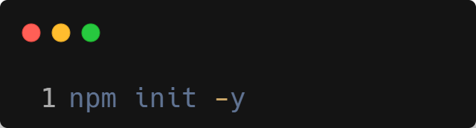
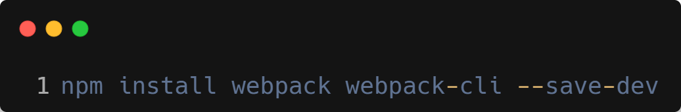
| Bundler (WebPack) Installation & Setup
Step 1 : Initialize your project (if not already)
Step 2 : Install Webpack and Webpack CLI:
webpack – the core bundler
webpack-cli – lets you run webpack from the command line

Slide 5
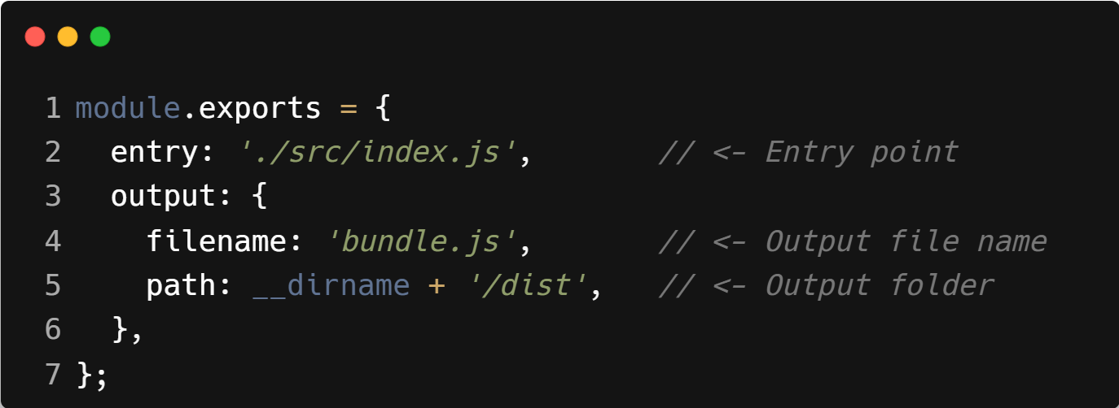
| Bundler (WebPack) Installation & Setup
Step 3 : Create a webpack.config.js file to configure it.
Step 4 : Set up entry and output points.
webpack.config.js file
entry: Where Webpack starts bundling (like your main index.js)
output: Where the final bundled file goes (like dist/bundle.js)

Slide 6
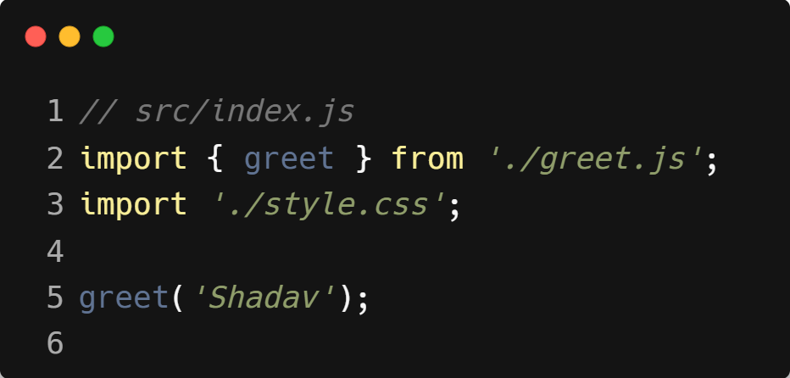
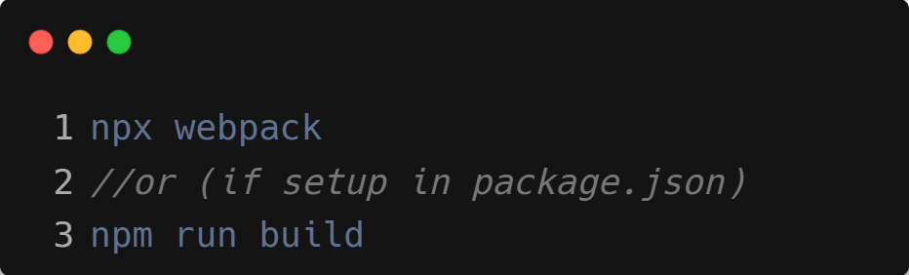
| Bundler (WebPack) Working
Step 1: You write modern JavaScript code
Step 2: You run Webpack in the terminal

Slide 7
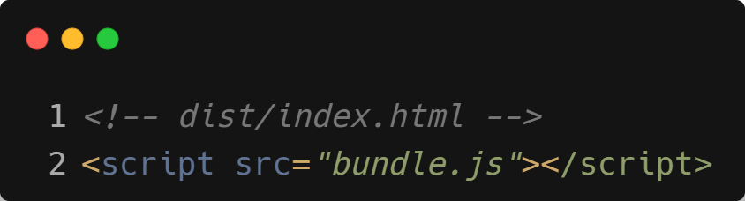
| Bundler (WebPack) Working
Step 3: You use the final bundle.js in your HTML

Slide 8
| What is Transpiler (Babel)?
A transpiler is a tool that converts modern JavaScript code (ES2020, JSX, etc.) into older, more widely-supported JavaScript (ES5) that can run in almost any browser.
Uses :
Modern JS features like:
let, const
arrow functions () => {}
template strings `Hello ${name}`
classes, spread/rest, optional chaining, JSX (React)
...are not supported in older browsers.

Slide 9
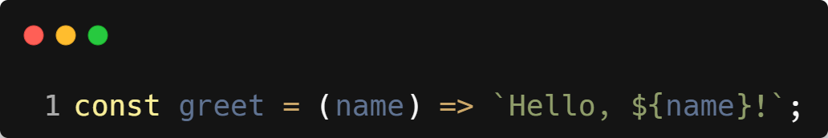
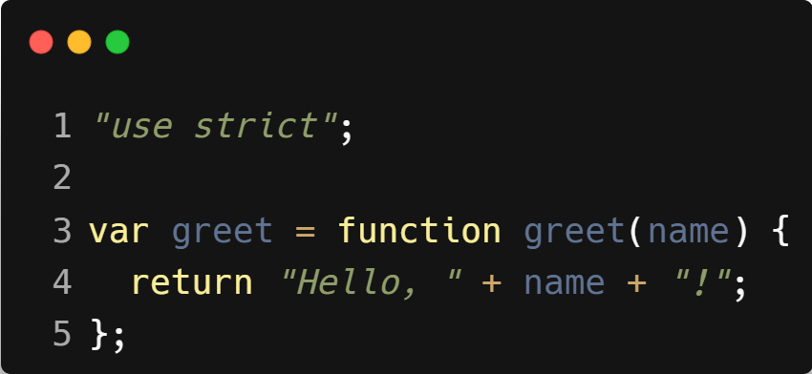
| What is Transpiler (Babel)?
If You Write :
Old browsers might throw errors.
Babel turns it into this:

Slide 10
| Bundler (WebPack) Installation & Setup
Step 1 : Initialize your project (if not already)
Step 2 : Install Babel & Its Core Packages
@babel/core – Babel compiler core
@babel/preset-env – Translates modern JS into older JS
babel-loader – Connects Babel to Webpack
webpack, webpack-cli – Bundler (optional but common)

Slide 11
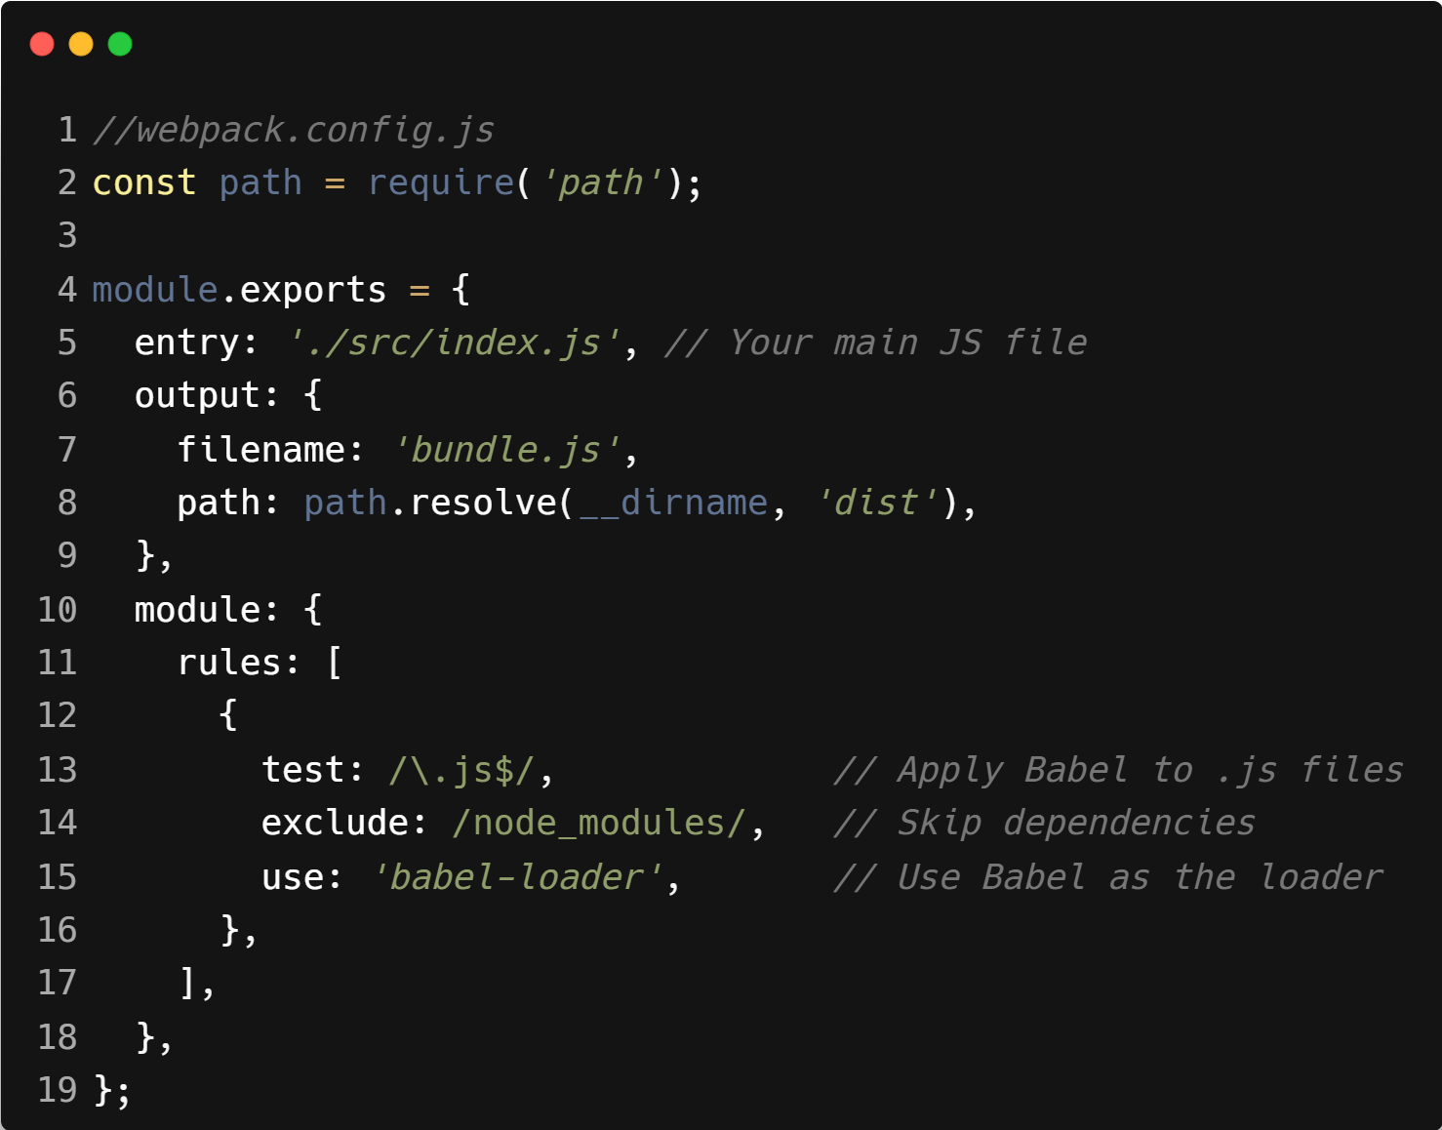
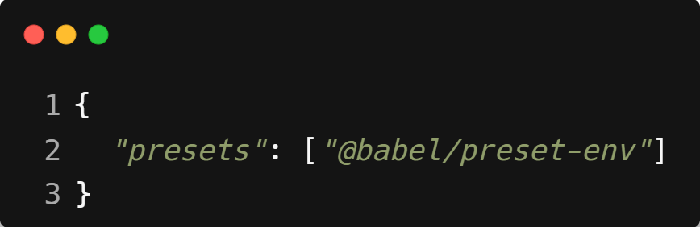
| Bundler (WebPack) Installation & Setup
Step 3 : Create a file called .babelrc in the root of your project
Step 4 : Setup Webpack to Use Babel

Slide 12
| Bundler (WebPack) Working
You write modern JS (or JSX).
Babel reads your code.
It uses presets (rules) to decide how to convert it.
Outputs older JavaScript code.

Slide 13

|
Do you really need Webpack and Babel just to say 'Hello World' in React?

Slide 14
|
Do you really need Webpack and Babel just to say 'Hello World' in React?
No, not at all!
If you're just getting started, experimenting, or building a quick demo — you don’t need to go through the complex setup of Webpack and Babel.
you can use React with just a single HTML file and a few <script> tags from a CDN. No installation, no setup, no configuration.
Setting up Webpack and Babel means:
Installing multiple npm packages
Creating config files (webpack.config.js, .babelrc)
Running CLI commands just to compile and bundle your code
It’s like building a factory to make a sandwich. Way too much for something simple.

Slide 15

| Check Your Understanding
Question : What is the role of a module bundler like Webpack?
Options : a) To check your JavaScript code for errors.
b) To run your JavaScript code on a server.
c) To take all your module files and combine them into a single file that the browser can execute.
d) To write your JavaScript code for you.
Answer : c) To take all your module files and combine them into a single file that
the browser can execute.
Explanation:
Browsers can be inefficient at loading many small files. A bundler like Webpack processes your application, follows the import/export chain, and bundles everything into an optimized, single file for production.

Slide 16
| Check Your Understanding
Question : What is the primary function of a transpiler like Babel?
Options : a) To bundle all JavaScript files into one.
b) To convert modern JavaScript (ES6+) code into an older version (like ES5) that is compatible
with more browsers.
c) To add a CDN link to your HTML file.
d) To automatically test your code.
Answer : c) To convert modern JavaScript (ES6+) code into an older version (like
ES5) that is compatible with more browsers.
Explanation:
Babel acts as a translator, allowing developers to use the latest JavaScript features without worrying about whether older browsers will understand them.

Slide 17
| References
MDN Web Docs : Comprehensive and official documentation for JS. 🔗https://developer.mozilla.org/en-US/docs/Web/JavaScript
W3Schools – JS Tutorial : Beginner-friendly JS tutorials with examples and interactive editors. 🔗 https://www.w3schools.com/js/
react.dev - A comprehensive, tutorial-style website that deeply explores core React concepts, including components, state, effects, and hooks, through interactive examples and in-depth explanations.
🔗https://react.dev/

Slide 18
Thanks
For
Watching
Course - Web Development - II
welcome@krmangalam.edu.in
Sohna Road,Gurugram,Haryana 122103

